Slide 1
Chapter 2 Objectives
The CCNA Topics Covered in this chapter include:
  Internetworking Basics
  Layered Models
  The OSI Model
  Ethernet Networking
  Data Encapsulation
  Cisco’s Three-Layer Model
  Chapter 1 Written Labs and Review Questions

Slide 2
Wireless Security
To provide a minimum level of security in a WLAN, we need two components:
- A means to decide who or what can use a WLAN. This
requirement is satisfied by authentication mechanisms
for LAN access control.
- A means to provide privacy for the wireless data.
The requirement is satisfied by encryption algorithms.

Slide 3
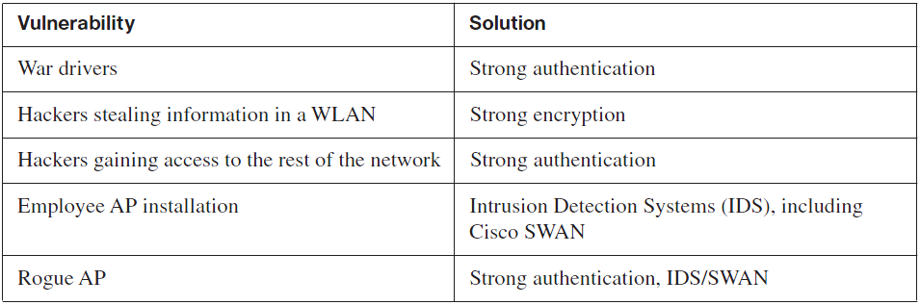
WLAN Vulnerabilities & Solutions

Slide 4
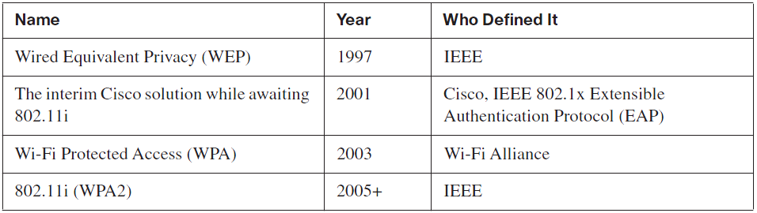
The Progression of WLAN Security Standards

Slide 5
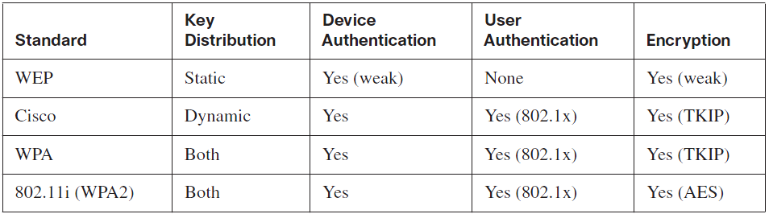
Comparisons of WLAN Security Features
WEP – Wired Equivalent Privacy
WPA – Wi-Fi Protected Access

